Slide 1








Codebasics Virtual Internship
Data Analyst Intern at AtliQ Technology
Presented by Rishi Kumar

Slide 2
Goal
The aim is to assist Shield Insurance in using a user- friendly dashboard packed with useful business insights to guide their decision-making with data.
Task
My role as a Data Analyst Intern is to talk with the client, study the data, and build a smart dashboard tailored to their needs.

Slide 3
About Shield Insurance
Shield Insurance is famous for giving all-encompassing insurance that protects people from unexpected things in life. They're trusted because they're really committed to providing dependable coverage

Slide 4

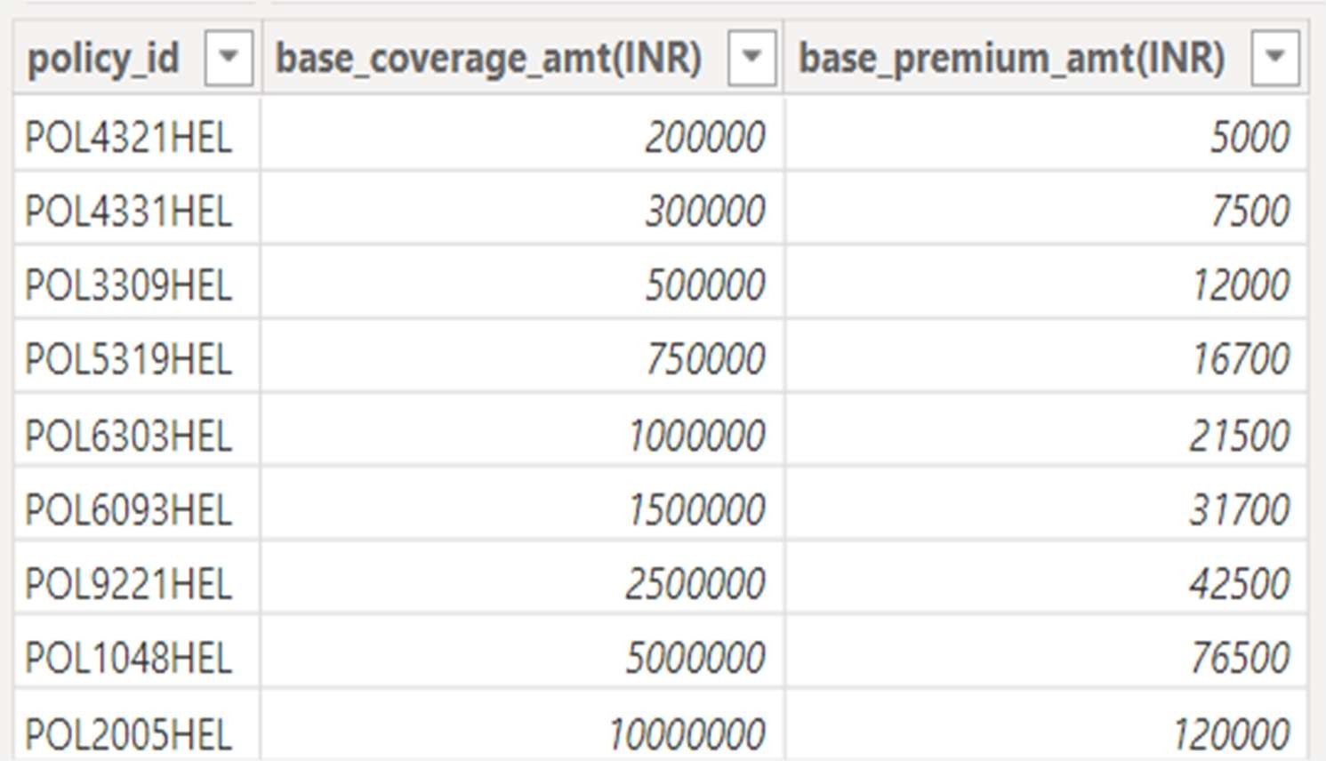
Policies
Shield Insurance provides a total of 9 policies

Slide 5






Sales Mode
Online
Offline
Online- Website
Offline- Agent
Online- App
Offline- Direct

Slide 6





Cities
Delhi NCR
Hyderabad
Indore
Chennai
Mumbai

Slide 7
Dataset
Dim_customer
Dim_policies
Dim_date
Fact_Premium
Fact_Settlement
Data was available from nov 2022 till apr 2023

Slide 8


















Slide 9


Slide 10

March 2023 Performance Peak: Witnessed the highest revenue and customer acquisition.
Delhi NCR Dominance: Led in revenue and customer acquisition among all cities.
Key Age Group Contribution: The 31-40 age group significantly contributed to both revenue and customer base
Sales Mode Impact: Offline-Agent sales mode attracted the most customers and generated the highest revenue.
Online Sales Dynamics: Online App and Website showed revenue growth from Feb 2023, while Offline-Direct declined.
Popular Policy: Policy 'POL4321HEL' with a base premium of ₹5,000/- gathered a customer base exceeding 4000.
Age Group Preference: The 31-40 age group appeared as the prominent customer base across all policies.

Slide 11
March Success Analysis: Investigate factors driving the exceptional performance in March for potential replicable strategies.
City-Wise Strategies: Leverage successful tactics from Delhi NCR to balance revenue growth across all cities.
Targeted Age Group Campaigns: Develop tailored marketing or policy offerings for the 31- 40 age group to further capitalize on their significance.
Online Sales Enhancement: Revamp the Offline-Direct mode by leveraging insights from successful Online App and Website sales.
Policy Expansion: Explore variations of the popular 'POL4321HEL' policy to attract a wider customer base across different demographics.

Slide 12




